Slide 1
House Prices: Advanced Regression Techniques

Slide 2
Modeling

Slide 3
Model Analysis
Prediction Models
Linear Regression
Gradient Boosting
Random Forests

Slide 4
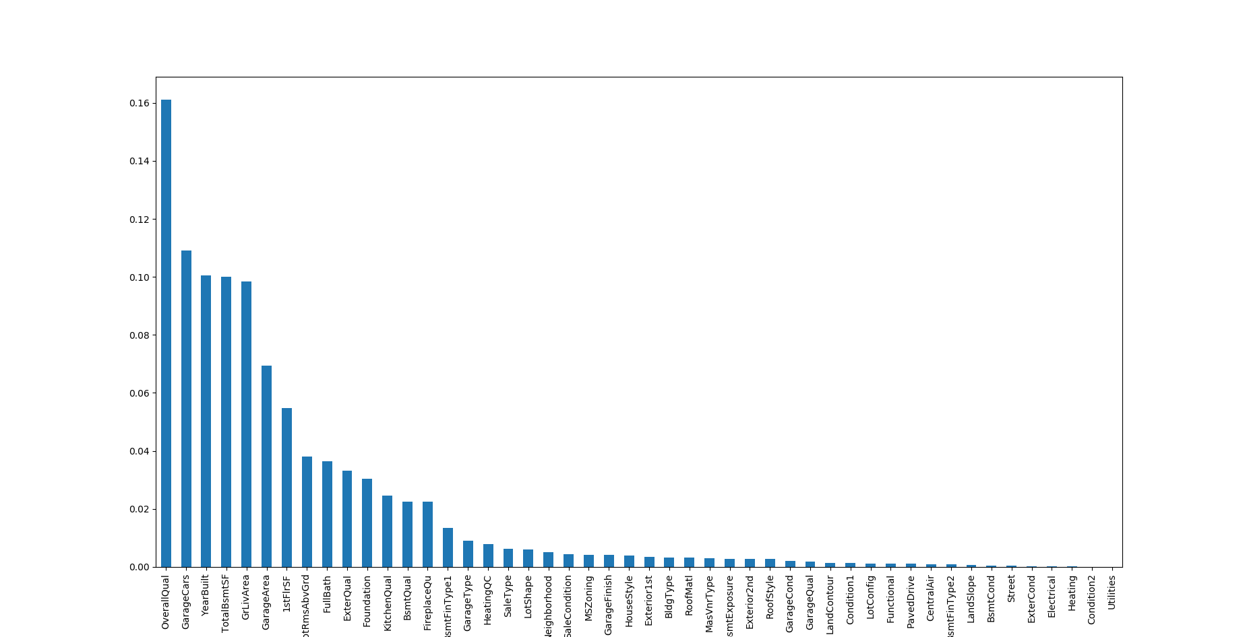
Feature Importance After Modeling

Slide 5
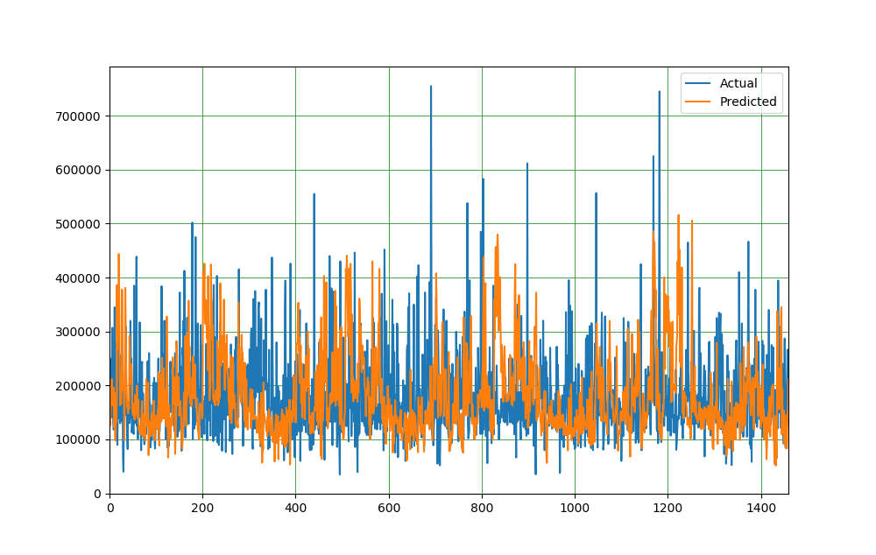
Plotting Training Data Prediction

Slide 6
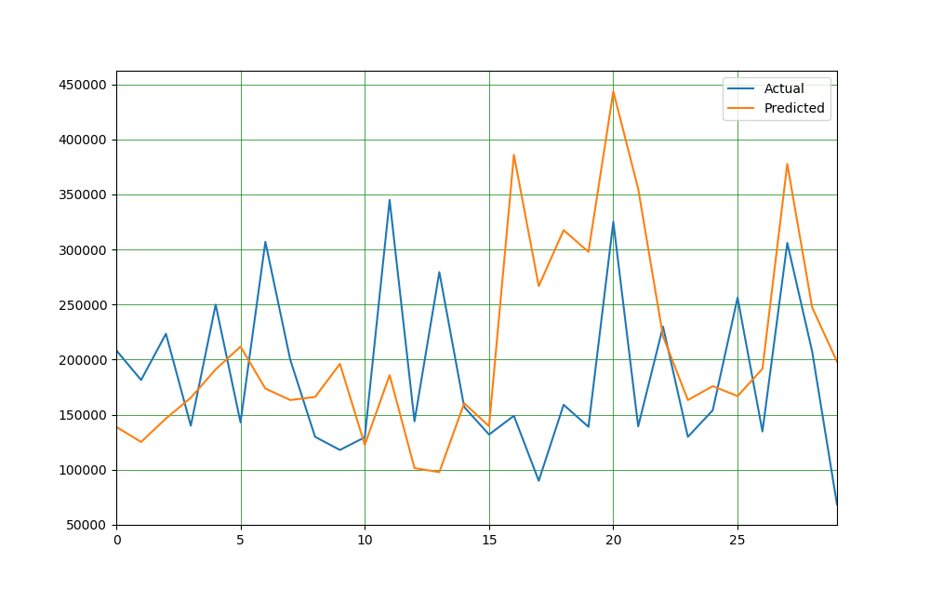

Slide 7
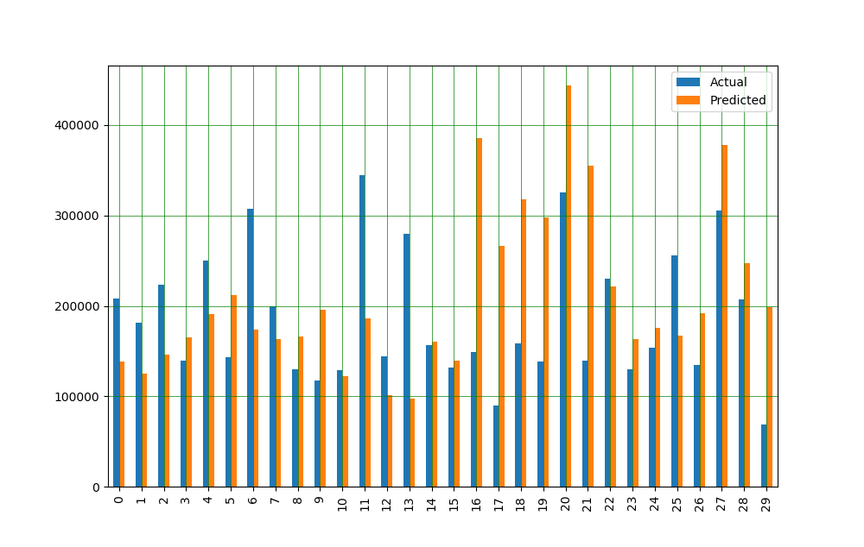

Slide 8
Models Tested
 | train score(R2) | test score
Linear Regression | 0.940049 | 0.940049
Lasso | 0.938488 | 8.306444e-01
Random Forest | 0.976609 | 0.976609

Slide 9
Selected Model Metrics
Random Forest Was Selected For Prediction Among All the Reviewed Models
Mean Absolute Error | 72766.25441891294
Mean Squared Error | 9144001264.357006
Mean Squared Error | 95624.27131412299

Slide 10
Thank You That's All.

